Slide 1




NEXT GEN EMPLOYABILITY PROGRAM
Creating a future-ready workforce
Team Members
College Name
Student Name :M.MONIKA
Student ID :510421104063
Arunai Engineering College

Slide 2

CAPSTONE PROJECT SHOWCASE
Project Title
Building Bus Reservation System using Python and Django
Abstract | Problem Statement | Project Overview | Proposed Solution | Technology Used | Modelling & Results | Conclusion

Slide 3
Abstract
The Online Bus Reservation System is a web-based platform designed to simplify the process of booking bus tickets for travelers. With the increasing demand for convenient and efficient travel solutions, this system provides an intuitive interface for users to search for available bus routes, select seats.
User Registration and Login: Travelers can create accounts or log in using their credentials to access the reservation system.
Seat Selection: The system allows users to view the available seats on selected buses and choose seats according to their preferences.
Booking Management: Users can manage their bookings, including viewing past bookings, cancelling reservations, and modifying travel details.
Admin Panel: The system includes an admin panel to manage bus schedules, seat availability, user accounts, and payment transactions.
The Online Bus Reservation System aims to enhance the overall travel experience by providing a convenient, reliable, and user-friendly platform for booking bus tickets. It streamlines the booking process, reduces manual errors, and ensures a seamless journey for passengers.
Source :

Slide 4
Problem Statement
Inconvenient Booking Process: The current process of booking bus tickets often involves visiting bus terminals, standing in long queues, or making phone calls to agents. This process is time-consuming, inconvenient, and prone to errors.
Manual Ticketing System: Many bus operators still rely on manual ticketing systems, which are prone to errors, ticket mismanagement, and fraudulent activities. There is a need for a digital solution that automates the ticketing process and ensures accuracy and security.
Operational Inefficiencies for Bus Operators: Bus operators face challenges in managing ticket inventories, optimizing bus schedules, and analyzing passenger data to make informed decisions. A digital reservation system can help streamline operations, improve efficiency, and enhance revenue generation for bus operators.
Overall, the development of a robust and user-centric bus reservation system website aims to address these challenges by providing travelers with a convenient, reliable, and secure platform for booking bus tickets online. By automating processes, enhancing transparency, and improving the overall user experience, the system seeks to revolutionize the way bus reservations are made and ensure a hassle-free travel experience for passengers.
Source :

Slide 5
Project Overview
User-Friendly Interface:
Ensure responsiveness across different devices (desktop, mobile, tablet) to cater to a wide range of users.
Comprehensive Search and Booking System:
Enable users to view seat availability, choose seats according to their preferences, and complete bookings seamlessly.
Real-Time Updates and Notifications:
Implement features to provide travelers with real-time updates and notifications about their bookings, including confirmation messages, seat allocations, and travel reminders.
Admin Panel for Bus Operators:
Develop an administrative panel to manage bus schedules, seat availability, user accounts, and payment transactions.
Scalability and Performance:
Design the system to be scalable and capable of handling a large volume of users and transactions efficiently.
Source :

Slide 6
Proposed Solution
.
Seat Reservation and Booking:
Provide an interactive seat map that allows users to view available seats, select preferred seats, and complete bookings seamlessly.
Implement features for group bookings, seat preferences, and special accommodations.
Real-Time Updates and Notifications:
Send real-time updates and notifications to users via email or SMS regarding booking confirmations, seat allocations, itinerary changes, and travel reminders.
Admin Dashboard for Bus Operators:
Develop an intuitive administrative dashboard for bus operators to manage bus schedules, seat inventory, pricing, and promotions.
Provide tools for analyzing booking data, generating reports, and optimizing route efficiency to enhance operational performance.
Source :

Slide 7


Technology Used
Front-end
Back-end
Source :

Slide 8
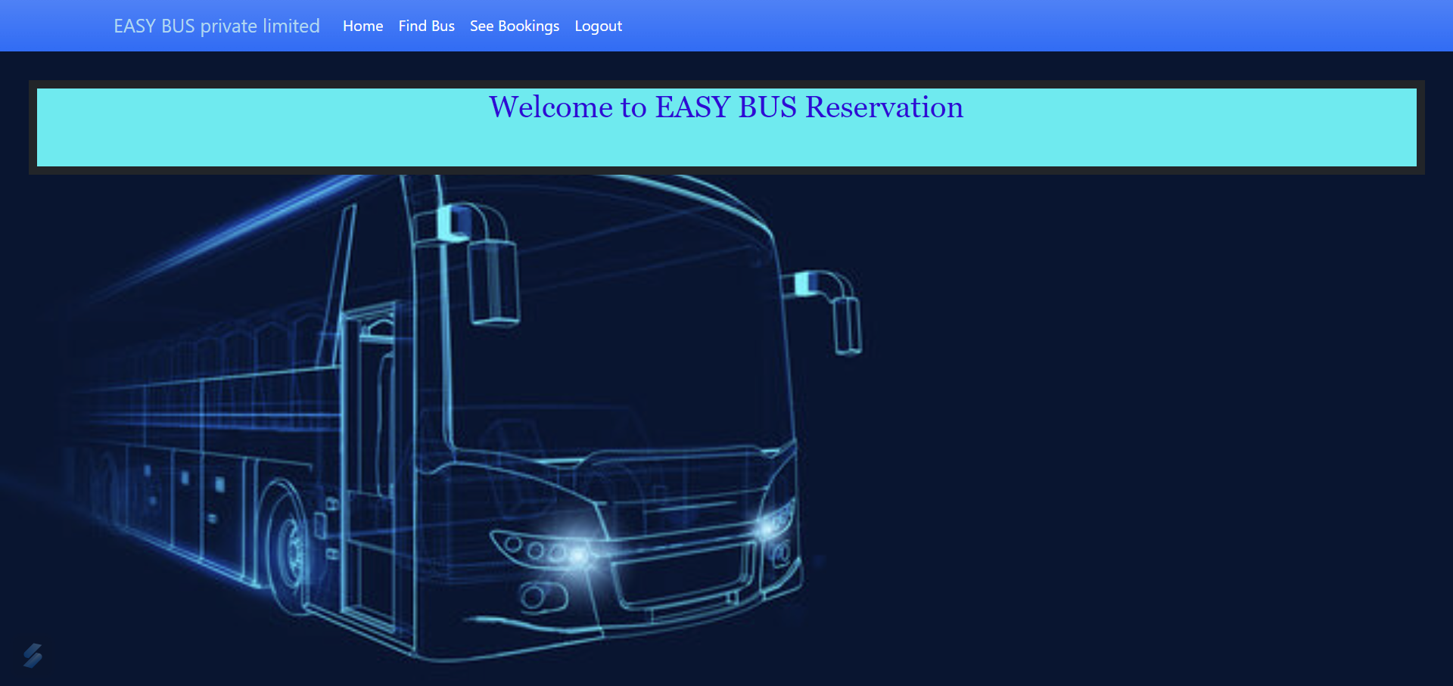
Modelling & Results
Source :

Slide 9
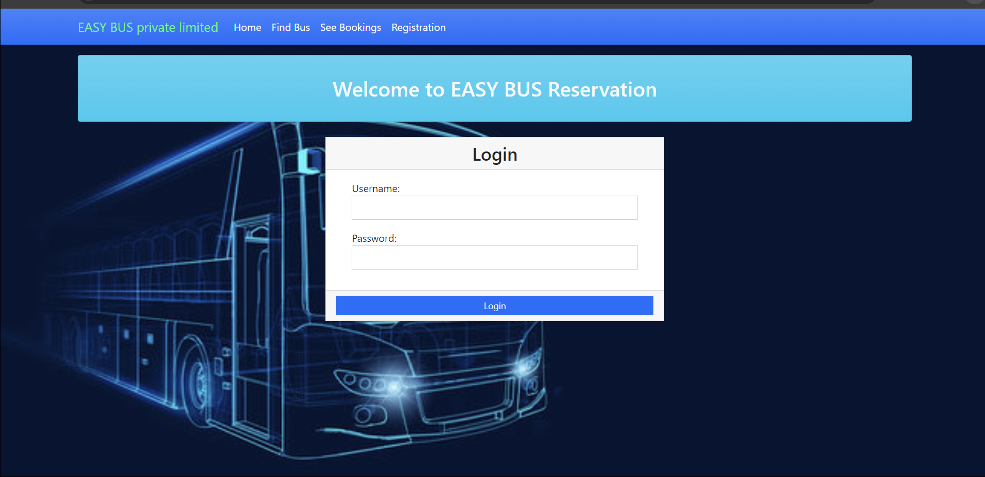
Homepage

Slide 10
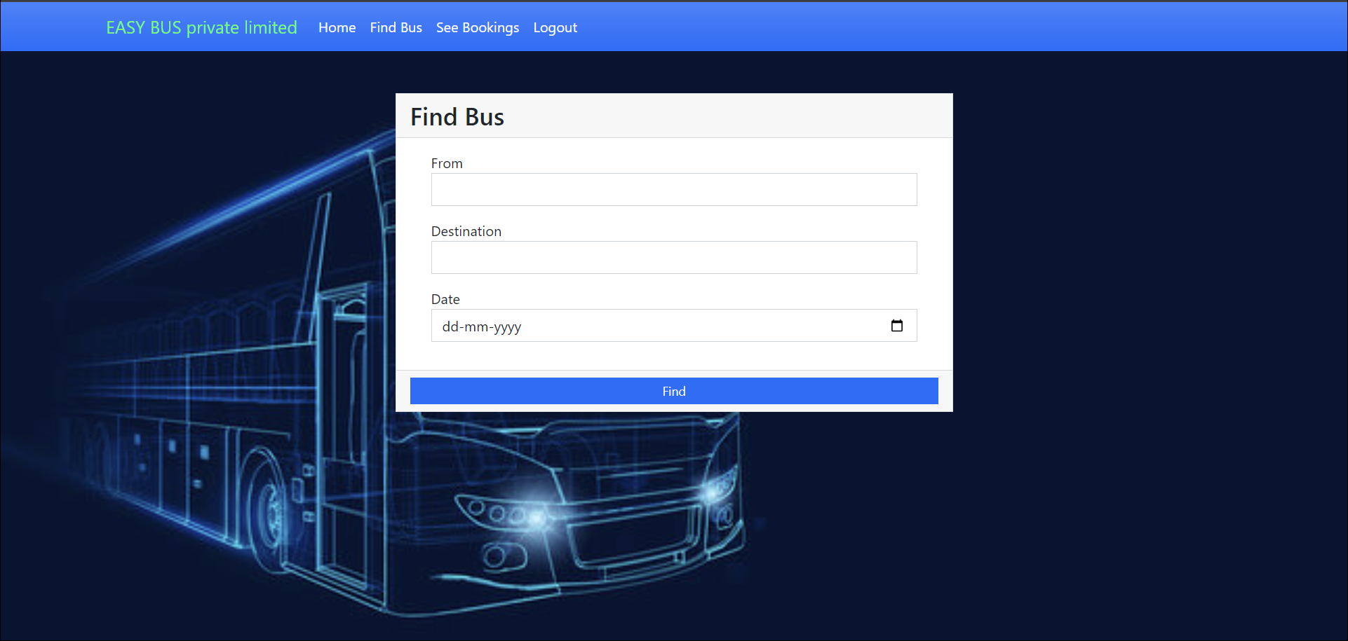
Find bus page

Slide 11
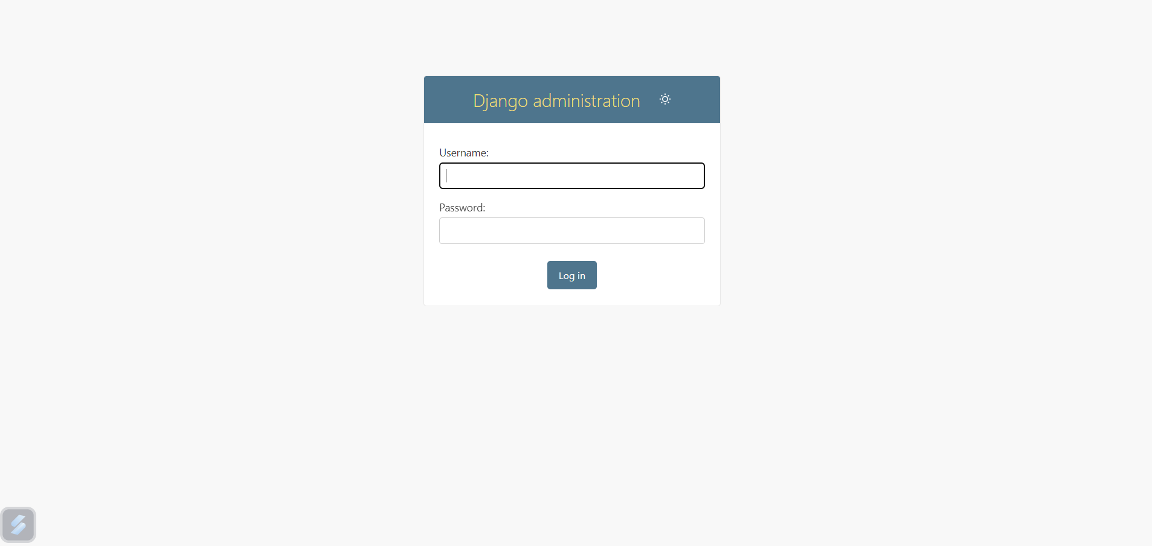
Admin login page

Slide 12
Future Enhancements:
Mobile Ticketing and QR Code Integration: Develop a mobile app for convenient ticket purchases, electronic boarding passes, and QR code scanning for seamless entry onto buses. This enhances mobility and eliminates the need for physical tickets, reducing paper waste and administrative overhead.
Environmental Sustainability Initiatives: Implement eco-friendly practices such as electric or hybrid buses, carbon offset programs, and paperless ticketing options. This demonstrates a commitment to environmental sustainability and reduces the system's carbon footprint.
Predictive Analytics and Forecasting: Utilize predictive analytics to forecast demand for specific routes and times, allowing bus operators to optimize schedules, allocate resources efficiently, and anticipate capacity constraints.

Slide 13
Conclusion
The development of the Bus Reservation System Website presents a significant opportunity to revolutionize the way bus reservations are made, enhancing convenience for travelers and efficiency for bus operators. By offering a user-friendly interface, comprehensive search and booking functionalities, secure payment processing, and real-time updates, the system aims to streamline the entire booking process.
In conclusion, the Bus Reservation System Website not only simplifies the booking experience for travelers but also provides bus operators with the tools they need to operate more efficiently and effectively. Through seamless integration, user-focused design, and robust functionality, the system strives to elevate the overall experience of bus travel for all stakeholders involved.
Source :

Slide 14
Thank You!
Notes:
Thank You !!

